Slide 1

Superstore Sales
Analysis
Python • Pandas • NumPy • Matplotlib
Presented by -- Rimi Singha

Slide 2
Table of Contents
01
Import Libraries & Load Dataset
06
Segment & Sub-Category Analysis
02
Data Exploration (Shape, Info, Stats)
07
Date & Time Analysis
03
Data Cleaning & Missing Values
08
Charts & Visualizations
04
Sales & Profit Analysis
09
Final Dashboard
05
Category & Region Analysis
10
Key Insights & Conclusion

Slide 3
Step 1 & 2 — Import Libraries & Load Dataset
1. Import Libraries
2. Load Dataset
● ● ●
● ● ●
import pandas as pd
import numpy as np
import matplotlib.pyplot as plt
df = pd.read_csv(
"superstore_sales_dataset.csv"
)
3. Display First & Last Rows
4. Dataset Shape & Columns
● ● ●
● ● ●
df.head() # First 5 rows
df.tail() # Last 5 rows
df.shape # Rows x Columns
df.columns # Column names
Always import libraries first — pandas, numpy, and matplotlib are the 3 core libraries for data analysis

Slide 4
Step 3 — Data Exploration
5. Dataset Info
6. Summary Statistics
● ● ●
● ● ●
df.info()
df.describe()
OUTPUT
OUTPUT
RangeIndex: 1000 entries
Columns: Order_ID, Sales,
Profit, Category, Region...
Sales: mean=229.8, max=22638
Profit: mean=28.6
Quantity: mean=3.8
7. Check & Fill Missing Values
● ● ●
df.isnull().sum() # Check missing
df.fillna(0, inplace=True) # Fill with 0
df.fillna(0) fills numeric columns with 0 — use str.strip() to fix column name spacing issues

Slide 5
Step 4 — Sales & Profit Analysis
Key Metrics Code
$2.3M
$286K
● ● ●
df["Sales"].sum() # Total Sales
df["Profit"].sum() # Total Profit
df["Quantity"].sum() # Total Quantity
df["Sales"].mean() # Average Sales
Total Sales
Total Profit
38K
$229
Sales & Profit by Category
● ● ●
Total Quantity
Avg Sale Value
df.groupby("Category")["Sales"].sum()
df.groupby("Category")["Profit"].sum()
groupby() is the most powerful function — groups data by a column and applies aggregations like sum(), mean()

Slide 6
Step 5 — Category & Region Analysis
Sales by Category
Sales by Region
● ● ●
● ● ●
df.groupby("Category")
["Sales"].sum()
.plot(kind="bar")
plt.title("Sales by Category")
plt.show()
df.groupby("Region")
["Sales"].sum()
.plot(kind="bar")
plt.title("Sales by Region")
plt.show()

Slide 7
Step 6 — Segment & Sub-Category Analysis
Segment Sales (Pie Chart)
Top Sub-Categories
● ● ●
● ● ●
df.groupby("Segment")
["Sales"].sum()
.plot(kind="pie",
autopct="%1.1f%%")
plt.title("Sales by Segment")
plt.show()
df.groupby("Sub_Category")
["Sales"].sum()
.sort_values(ascending=False)
.head(10)
.plot(kind="bar")
plt.title("Sales by Sub Category")
plt.show()

Slide 8
Step 7 — Date & Time Analysis
Convert & Extract Date Parts
● ● ●
# Convert to datetime
df["Order_Date"] = pd.to_datetime(df["Order_Date"])
# Extract Year and Month
df["Year"] = df["Order_Date"].dt.year
df["Month"] = df["Order_Date"].dt.month
Yearly & Monthly Sales
Yearly Trend Chart
● ● ●
● ● ●
df.groupby("Year")["Sales"].sum()
df.groupby("Month")["Sales"].sum()
df.groupby("Year")["Sales"]
.sum().plot(kind="line")
plt.title("Yearly Sales Trend")
plt.show()
pd.to_datetime() converts string dates to proper date format — always do this before extracting year/month

Slide 9
Step 8 — Charts & Visualizations
Yearly Sales Trend (Line)
Sales vs Profit (Scatter)
● ● ●
● ● ●
year_sales = df.groupby("Year")
["Sales"].sum()
year_sales.plot(kind="line")
plt.title("Yearly Sales Trend")
plt.show()
plt.scatter(
df["Sales"],
df["Profit"]
)
plt.title("Sales vs Profit")
plt.show()

Slide 10
Step 9 — Dashboard Code (Part 1: Prepare Data)
Calculate all aggregations before plotting:
● ● ●
# Calculate all sales data first
category_sales = df.groupby("Category")["Sales"].sum()
region_sales = df.groupby("Region")["Sales"].sum()
segment_sales = df.groupby("Segment")["Sales"].sum()
sub_sales = df.groupby("Sub_Category")["Sales"]
.sum().sort_values(ascending=False)
df["Order_Date"] = pd.to_datetime(df["Order_Date"])
df["Year"] = df["Order_Date"].dt.year
year_sales = df.groupby("Year")["Sales"].sum()
Always prepare all aggregated data variables BEFORE creating the dashboard layout

Slide 11
Step 9 — Dashboard Code (Part 2: Plot & Save)
Create 2x3 grid and plot all 6 charts:
● ● ●
fig, axs = plt.subplots(2, 3, figsize=(18, 10))
axs[0,0].bar(category_sales.index, category_sales.values)
axs[0,0].set_title("Sales by Category")
axs[0,1].bar(region_sales.index, region_sales.values)
axs[0,1].set_title("Sales by Region")
axs[0,2].pie(segment_sales.values, labels=segment_sales.index, autopct="%1.1f%%")
axs[0,2].set_title("Sales by Segment")
axs[1,0].bar(sub_sales.index[:8], sub_sales.values[:8])
axs[1,0].set_title("Top Sub Categories")
axs[1,0].tick_params(axis="x", rotation=45)
axs[1,1].plot(year_sales.index, year_sales.values)
axs[1,1].set_title("Yearly Sales Trend")
axs[1,2].scatter(df["Sales"], df["Profit"])
axs[1,2].set_title("Sales vs Profit")
fig.suptitle("Superstore Sales Dashboard", fontsize=18)
plt.tight_layout()
plt.savefig("superstore_dashboard.png", bbox_inches="tight", dpi=150)
plt.show()

Slide 12
Step 10 — Save & Export Results
Export Data to CSV
Save Dashboard as Image
● ● ●
● ● ●
# Save cleaned data
df.to_csv(
"exported_store_sales.csv",
index=False
)
# Save dashboard PNG
plt.savefig(
"superstore_dashboard.png",
bbox_inches="tight",
dpi=150
)
plt.show()
Check Working Directory
● ● ●
import os
os.getcwd() # Shows: C:\Users\HP\python
Important: savefig() must come BEFORE plt.show() — otherwise the saved PNG will be blank!

Slide 13
Step 11 — Final Insights
● ● ●
# Print Final Insights
print("Technology category has high sales.")
print("Some regions generate more profit.")
print("Sales trend increases over time.")
Technology Leads
West Region Best
01
02
Technology category generates highest sales revenue across all categories.
West and East regions outperform Central and South in total sales value.
Growing Trend
Consumer Segment
03
04
Yearly sales show consistent upward growth from 2018 to 2022.
Consumer segment accounts for ~50% of all sales — largest customer group.
Phones #1 Product
Profit vs Sales
05
06
Phones and Chairs are the top two sub-categories by total sales.
Some high-sales transactions show negative profit — needs attention.

Slide 14
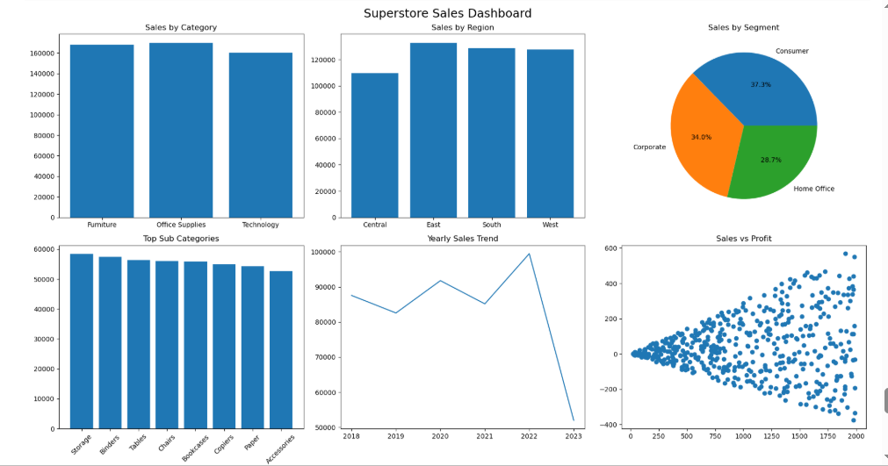
Superstore Sales Dashboard

Slide 15
Thank You!
Superstore Sales — Python Analysis
Python • Pandas • NumPy • Matplotlib
www.linkedin.com/in/rimi-singha-3093b532b
6294653977
rimi.singha01@gmail.com
Berhampore ,West Bengal

